Slide 1
Less Product, More Joy
Practical Approaches for Reappraisal, Weeding, and Deaccessioning

Slide 2
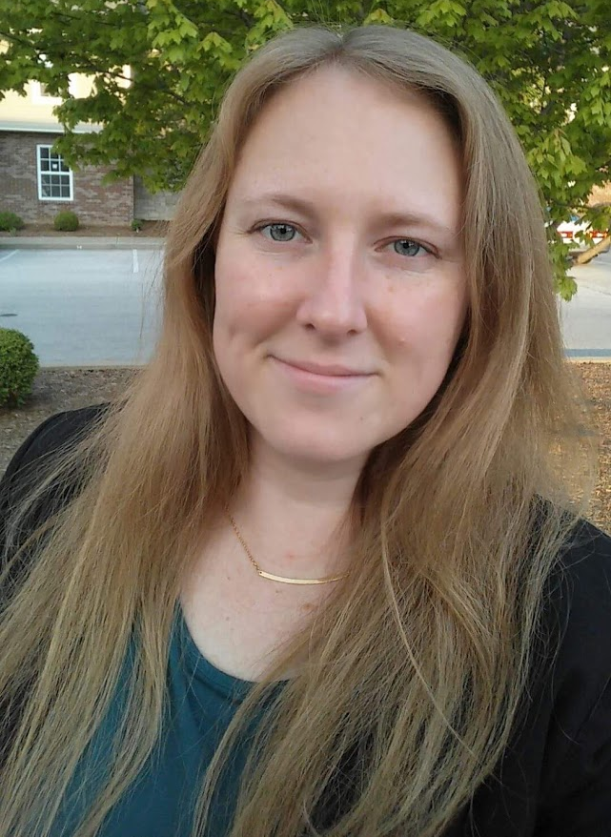
Instructors
Tricia Gilson
Archivist
Columbus Indiana Architectural Archives
Jeannine Roe
Electronic Records Archivist
Indiana Archives & Records Administration

Slide 3
Agenda
Morning
8:30-9:00 Arrival/Registration
9:00-9:15 Welcome/Introductions
9:15-10:30 A Common Vocabulary
10:30-10:40 Break
10:40-11:45 Less Product 1
11:45-1:00 Lunch on your own
Afternoon
1:00-2:30 Refusing Refuse
2:30-2:45 Break
2:45-4:00 Less Product 2
4:00-4:15 More Joy - Giveaways!
Tour of CIAA
Networking at Pump House

Slide 4
A Common Vocabulary:
Definitions, Policies, and the Whys of Reappraisal
Definitions are from the Glossary of Archival and Records Terminology published by the Society of American Archivists.
www2.archivists.org/glossary

Slide 5
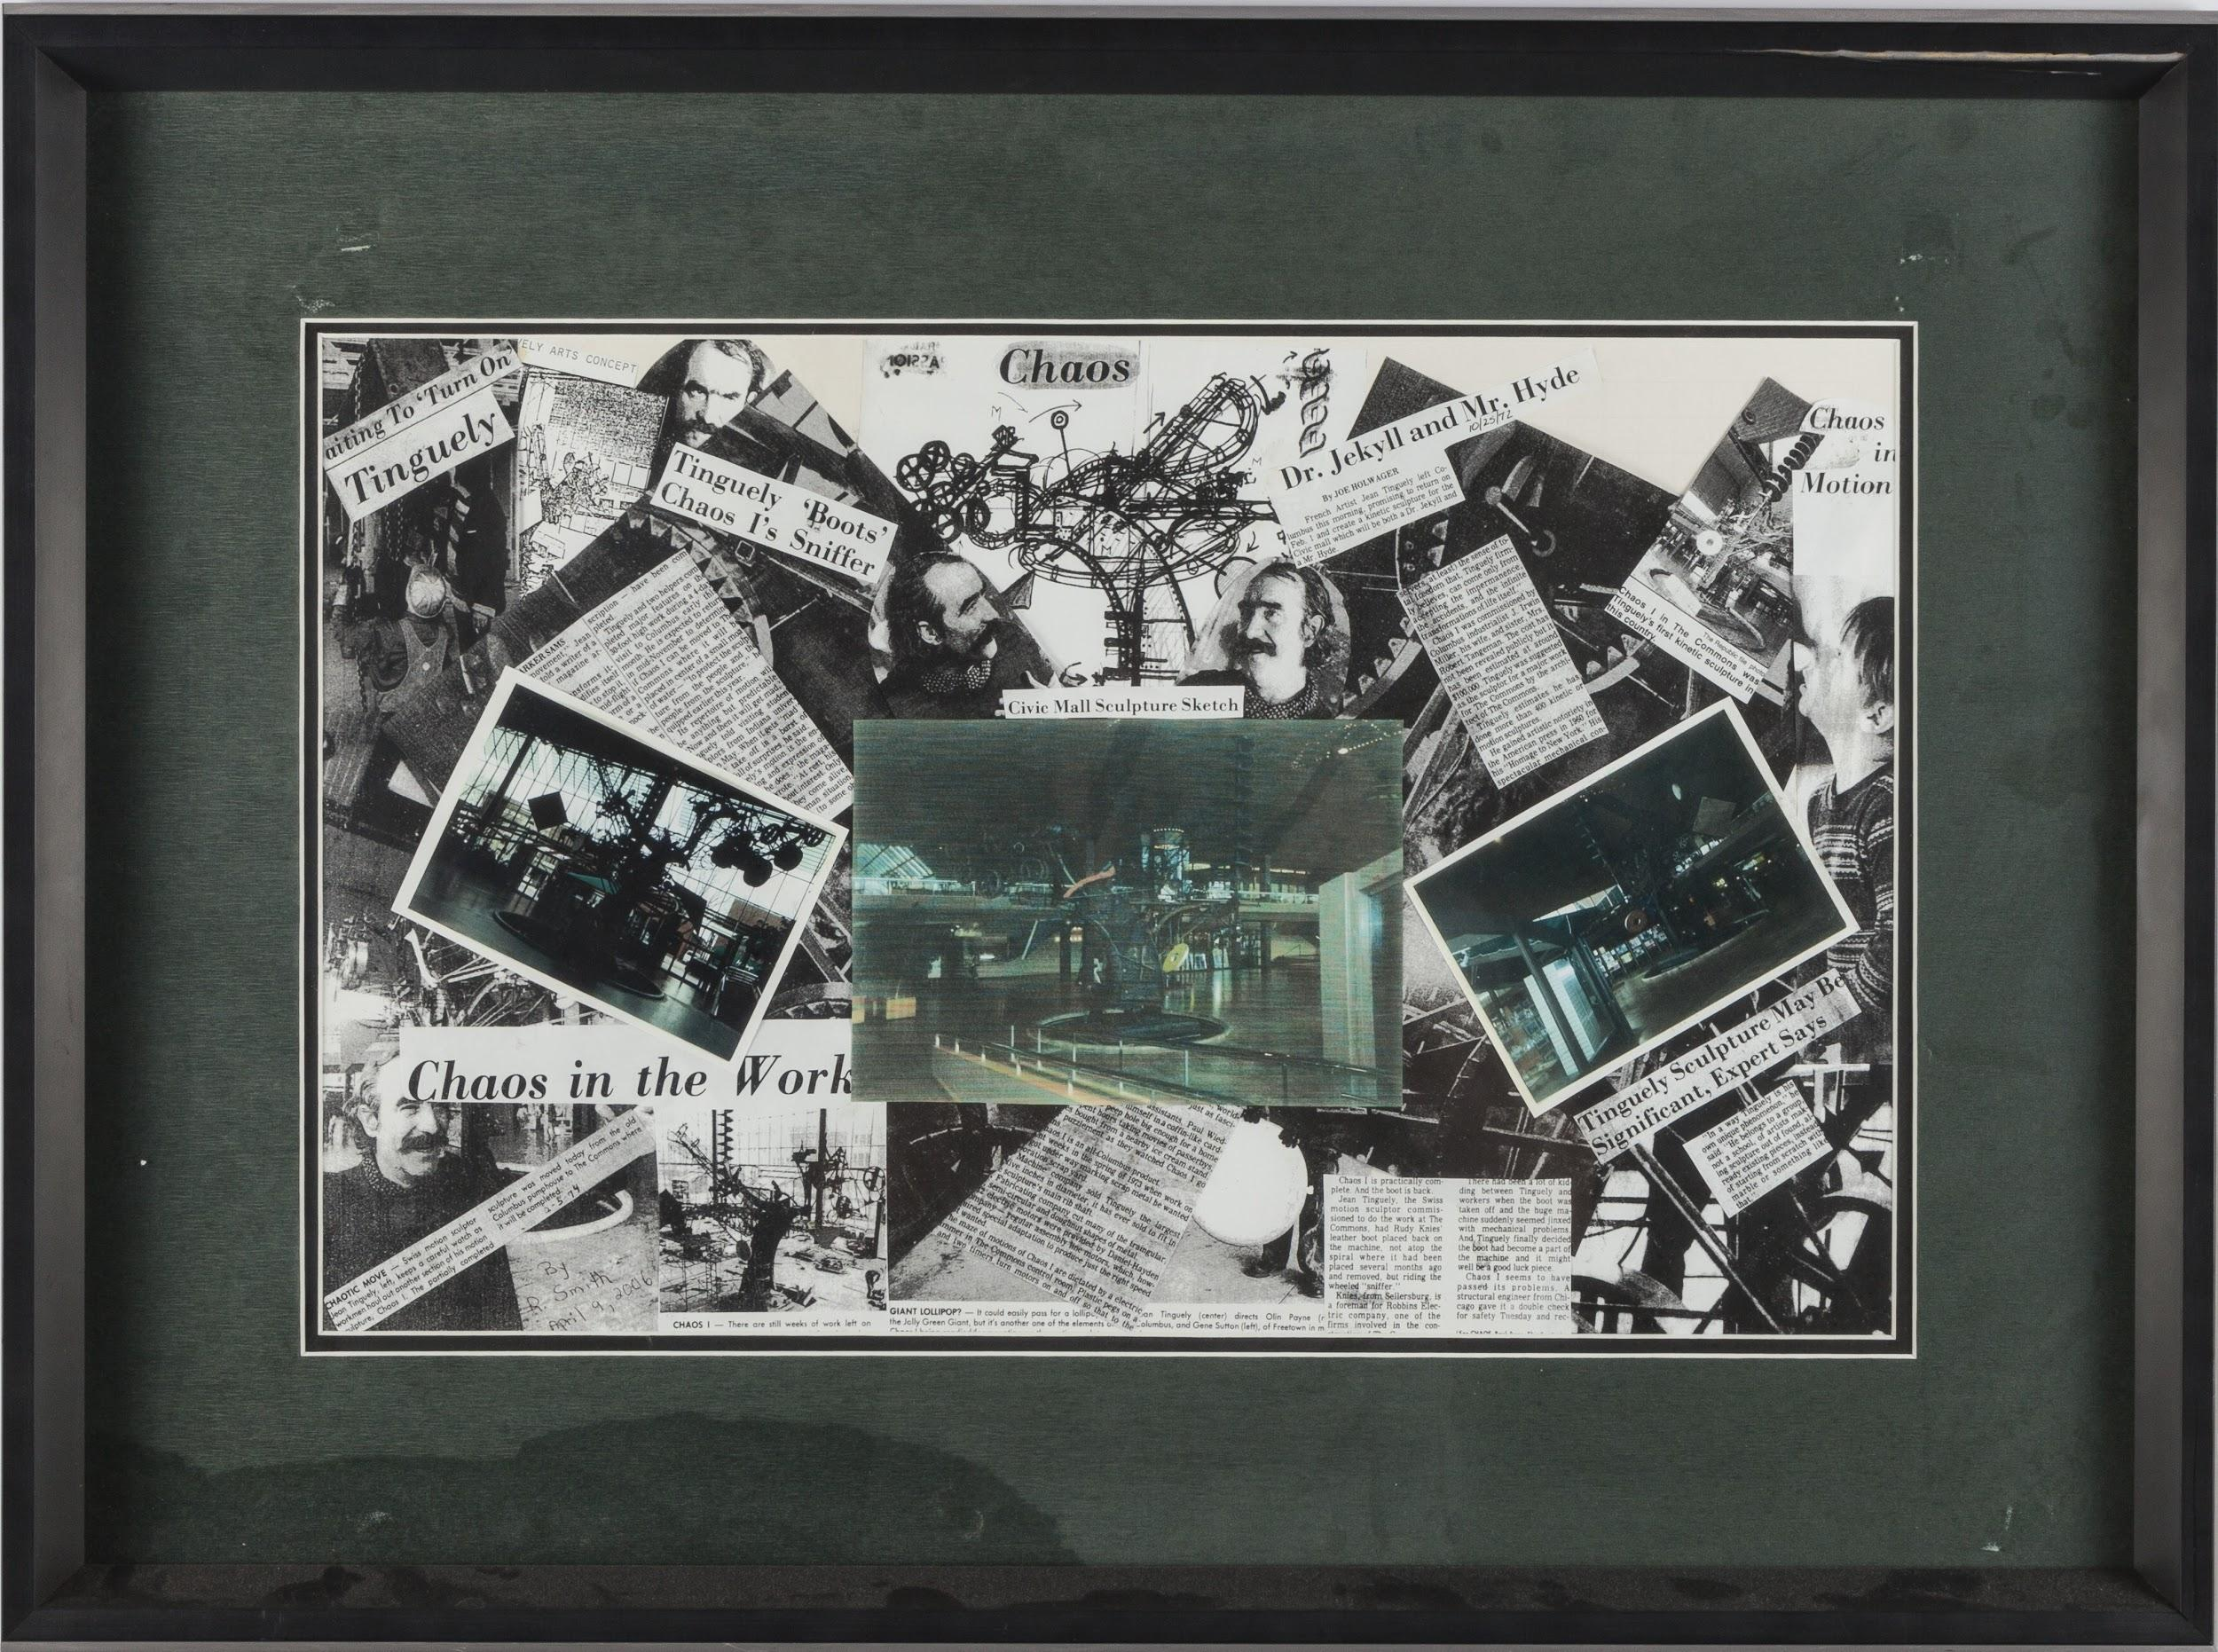
Have you ever asked yourself…
Why do we have this?

Slide 6
collection development
The function within an archives or other repository that establishes policies and procedures used to select materials that the repository will acquire, typically identifying the scope of creators, subjects, formats, and other characteristics that influence the selection process.

Slide 7
retention schedule
A document that identifies and describes an organization's records, usually at the series level, provides instructions for the disposition of records throughout their life cycle.

Slide 8
Have you ever asked yourself…
Do we really have to keep this?

Slide 9
reappraisal
1. Archives · The process of identifying materials that no longer merit preservation and that are candidates for deaccessioning.
2. Records management · The process of reviewing materials to reassess their retention value.

Slide 10
Have you ever asked yourself…
What were they thinking?
Why did they collect that?
Why wouldn’t they have done it this way?
Who thought this was a good idea?
Homer Simpson by Matt Groening. Image retrived from https://tenor.com/view/homer-fist-angry-the-simpsons-gif-5303966

Slide 11
Possible Answers
(Or Reasons for Reappraisal)
What were they thinking?
Original appraisal was unsound.
Why did they collect that?
The collecting policy has changed.

Slide 12
Possible Answers
(Or Reasons for Reappraisal)
Why wouldn’t they have done it this way?
Processing methods have changed.
Who thought this was a good idea?
Perceived value of materials have changed.

Slide 13
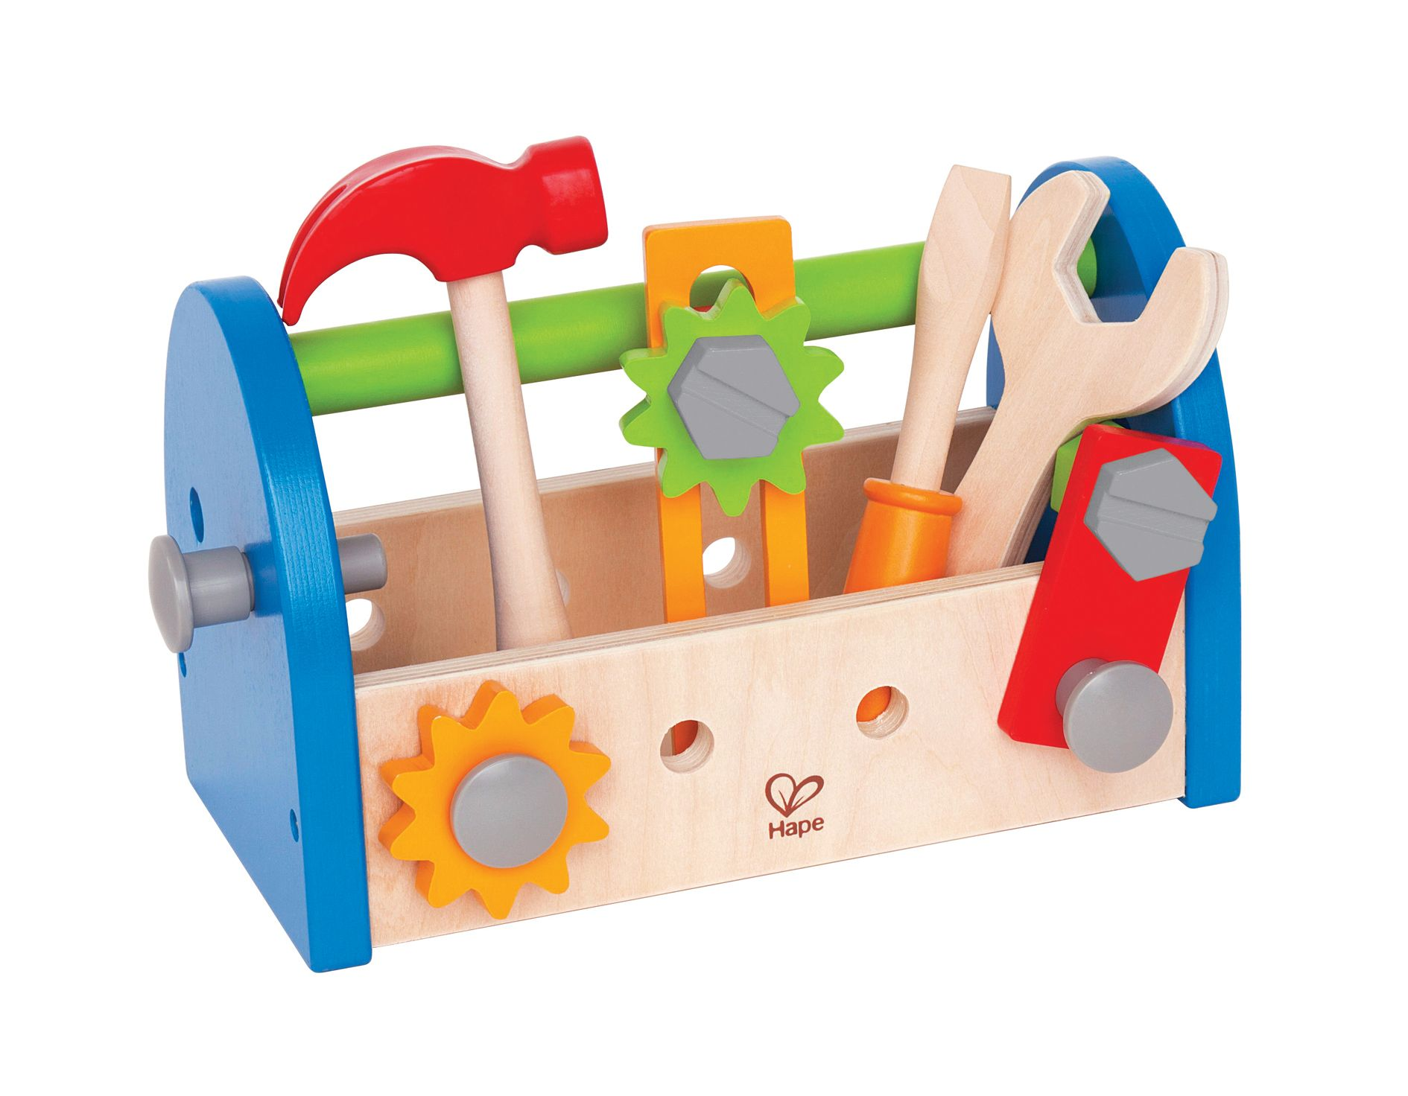
Reappraisal is a collection management tool!
Reappraisal
Hape Fix it Kid’s Wooden Tool Box and Accessory Play Set. Image retrieved from https://www.hape.com/fr/en/toy/fix-it-tool-box/E3001

Slide 14
So, too, is deaccessioning.
deaccessioning
The process by which an archives, museum, or library permanently removes accessioned materials from its holdings.

Slide 15
disposal
The transfer of records, especially noncurrent records, to their final state, either destruction or transfer to an archives.

Slide 16
Reappraising ≠ Deaccessioning ≠ Weeding
weeding
The process of identifying and removing unwanted materials from a larger body of materials.

Slide 17
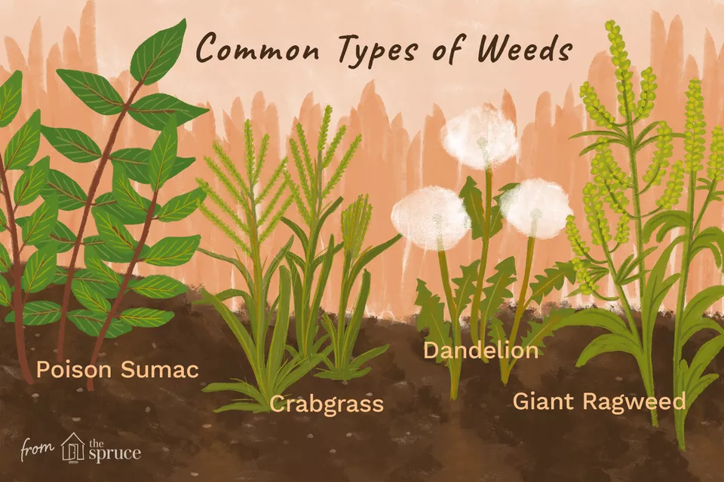
Image adapted from https://www.thespruce.com/pictures-of-weeds-4069715
Duplicates
Blank forms
Scrap paper
Medical Info

Slide 18
Less Product 1:
Scenarios with paper and artifacts
SAA’s Guidelines for Reappraisal and Deaccessioning
[2017]

Slide 19
CIAA Collection Development Policies
2005 Collect everything and anything related to architecture in Bartholomew County.
2014 Collect material related to significant modern architecture, landscape architecture, public planning, and public art in Bartholomew County.
2018 CIAA becomes part of county library.
2019 Somewhere between 2005 and 2014.

Slide 20
Step 1
Have a rationale and clear objectives.
Mission changed.
Collecting policy changed.
Refine scope & comply with collecting policy.
Provide better access.
Balance research potential with resources.

Slide 21
Step 2
Get ready! Get set!
Review state abandoned property laws.
Review your collecting policy.
Review your collection management policy.
Identify scope. (Entire collection, format, subject?)
Get approval.

Slide 22
Step 3
Go! Reappraise!
Gather data about collection.
Determine ownership.
Make a decision to retain, defer, or deaccession.
Follow through with decision.

Slide 23
Activity: Make some decisions!
Does collection fit within collecting or records management policy?
How often is it used?
Would it be better somewhere else?
What is the condition and what are preservation costs?
What is the potential research value?
Are we required to retain certain records?
Retain? Defer? Deaccession? Something else?

Slide 24
CIAA’s Decisions
C0001 Retain
C0002 Weed (not yet processed or inventoried)
C0003 Deaccession (some) models & exhibit materials
C0004 Retain
C0005 Retain
C0006 Defer

Slide 25
CIAA’s Decisions
C0007 Sample (retain some, deaccession some)
C0008 Retain
C0009 Weed
C0010 Retain
C0011 Deaccession multiplicates
C0012 Deaccession subseries

Slide 26
CIAA’s Decisions
C0014 Retain
C0015 Sample (retain some, deaccession some)
C0017 Defer
C0025 Retain
C0027 Sample (retain some, deaccession some)
C0033 Deaccession

Slide 27
Step 4
Deaccession (if that’s your decision)!
Transfer.
Return.
Sell.
Destroy.
(Remember to complete all documentation.)

Slide 28
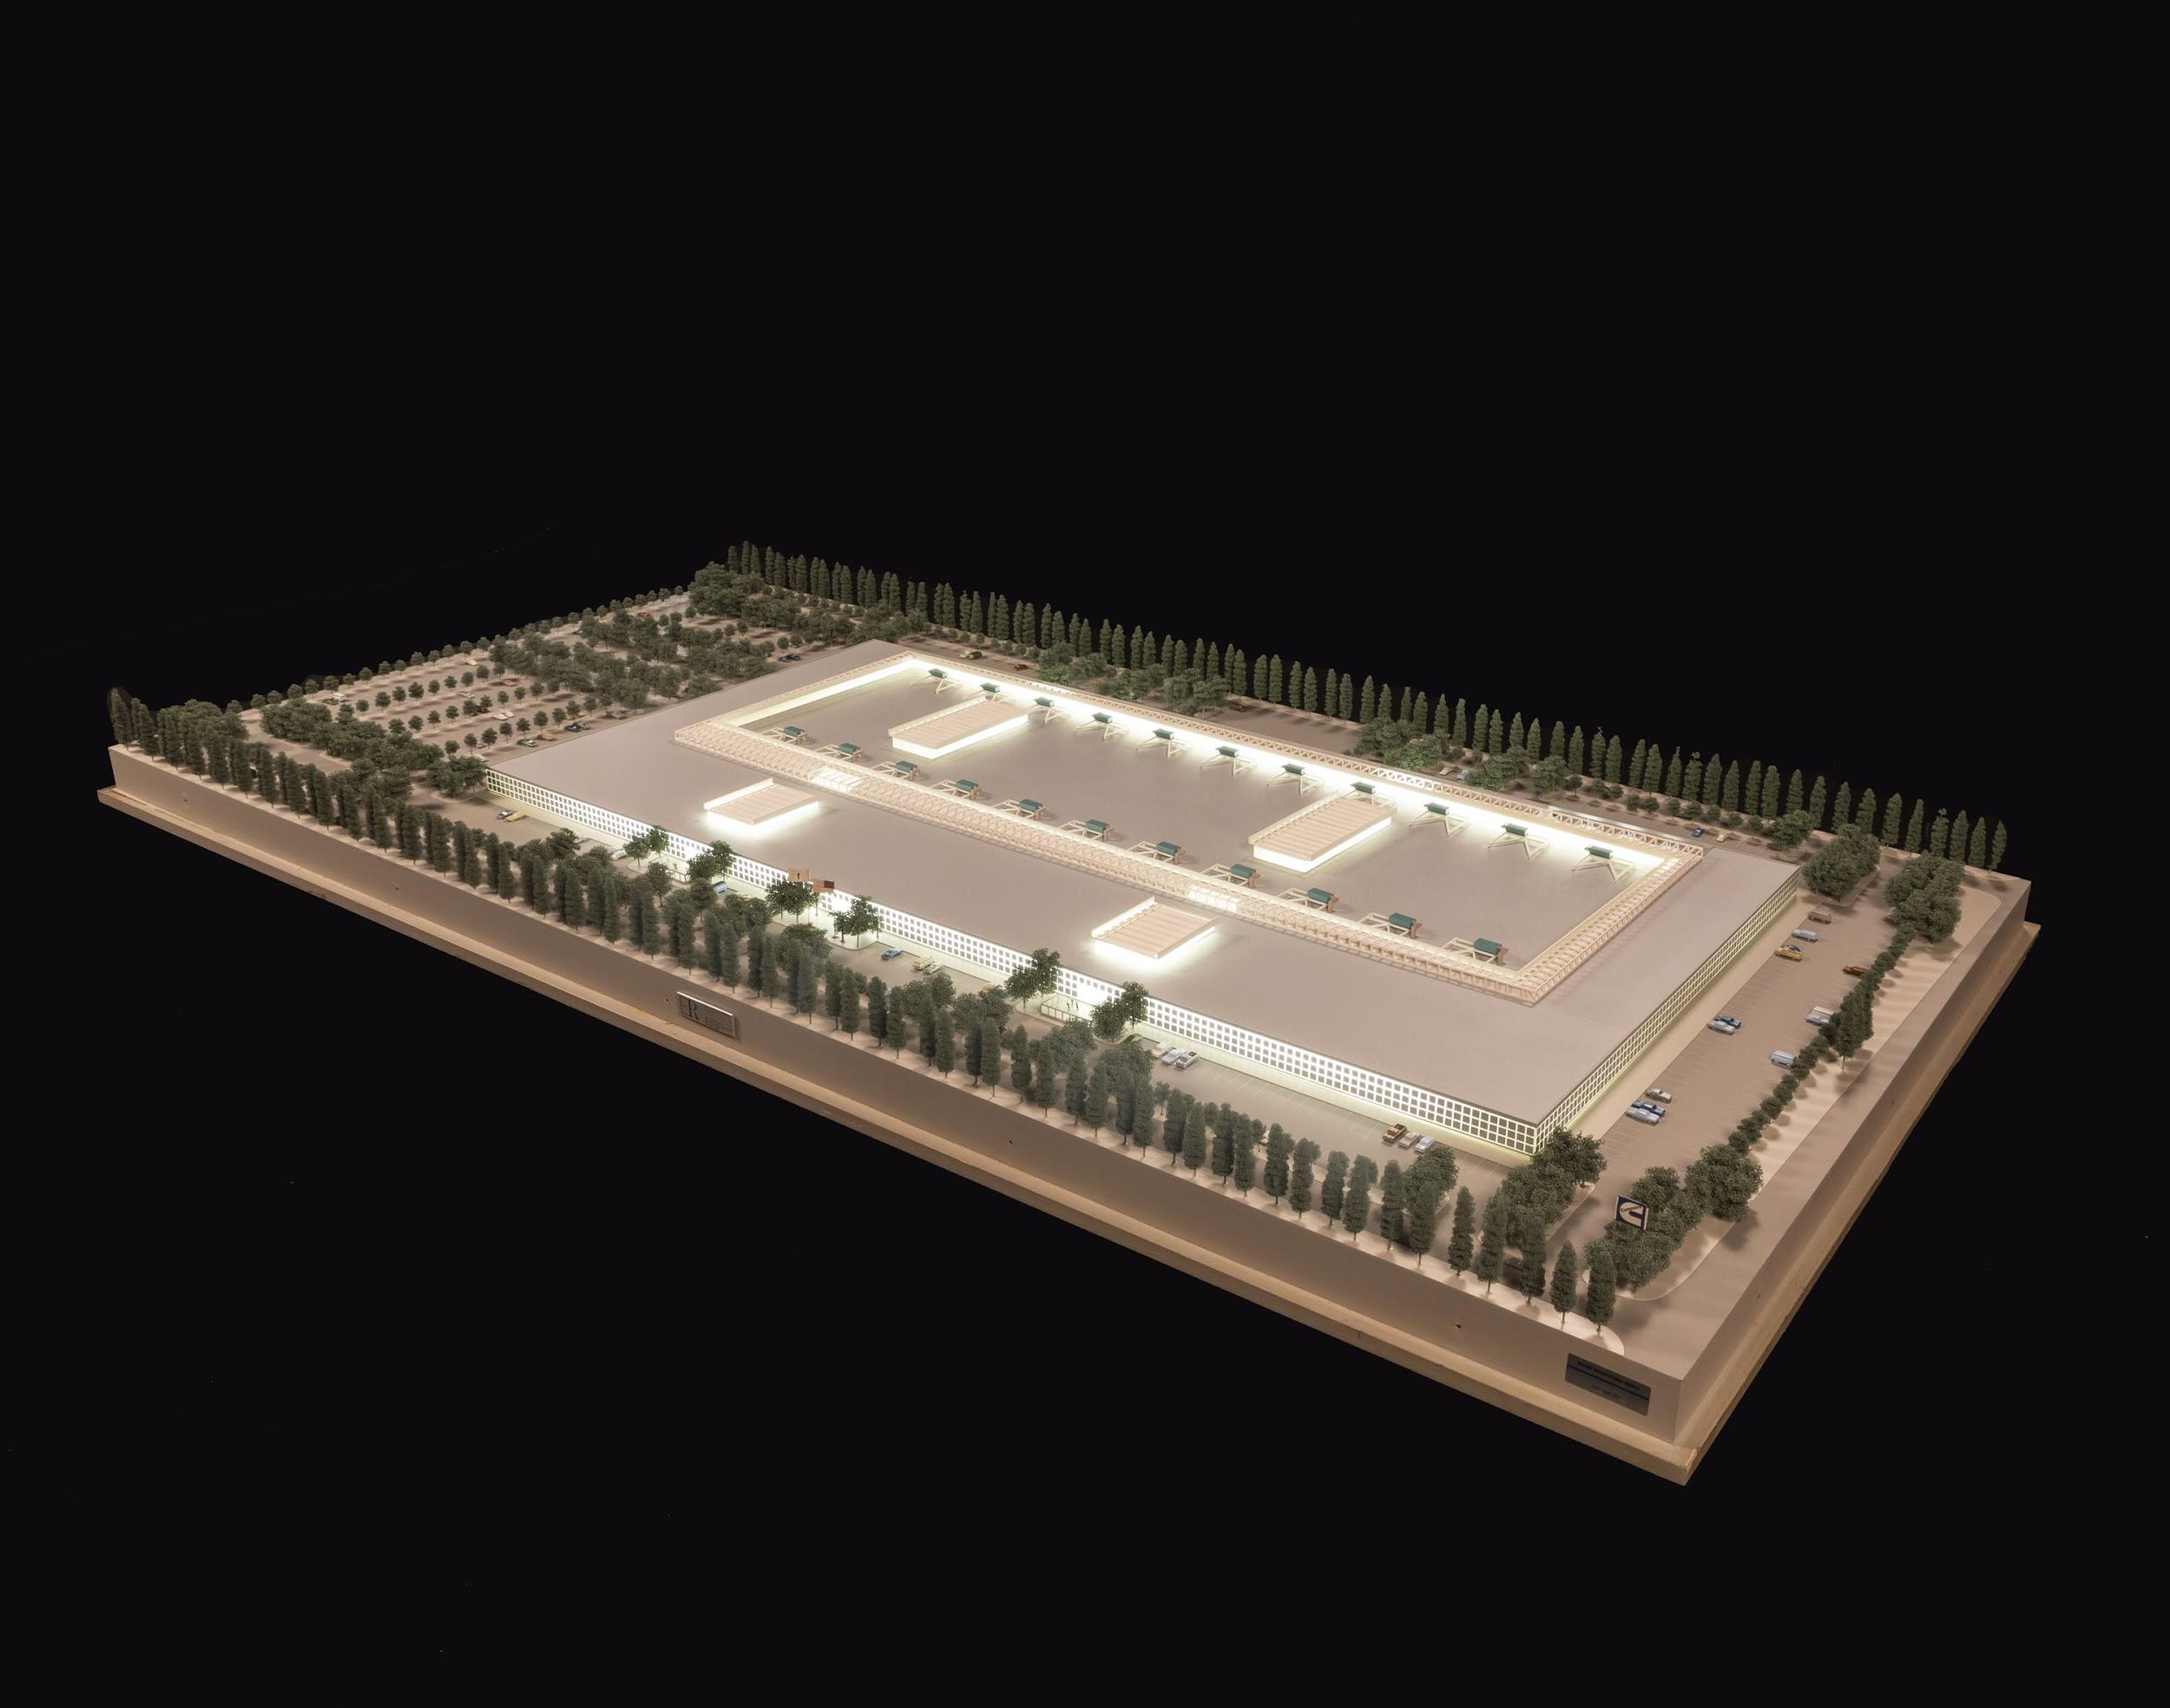
Out of scope.
Transferred to another archive.

Slide 29
Out of scope.
Destroyed.

Slide 30
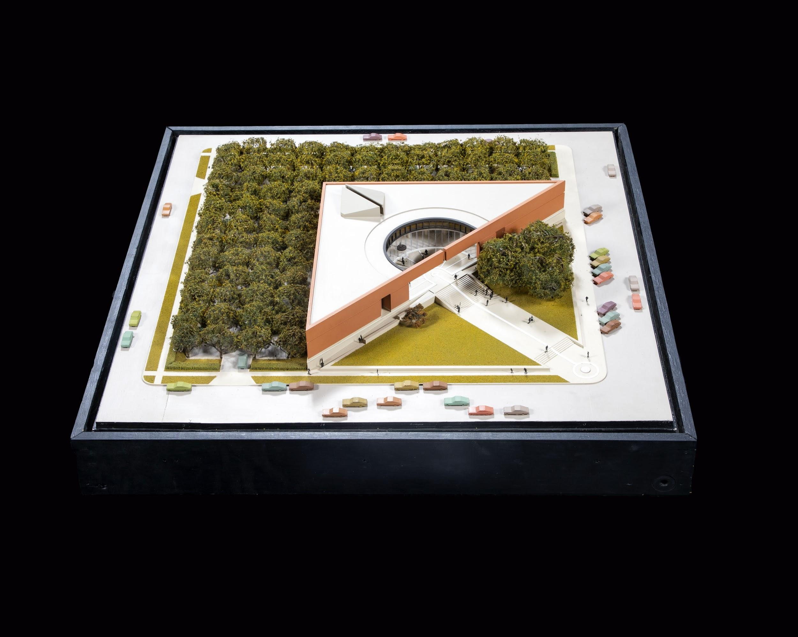
Low research value.
Transferred to building owner.

Slide 31
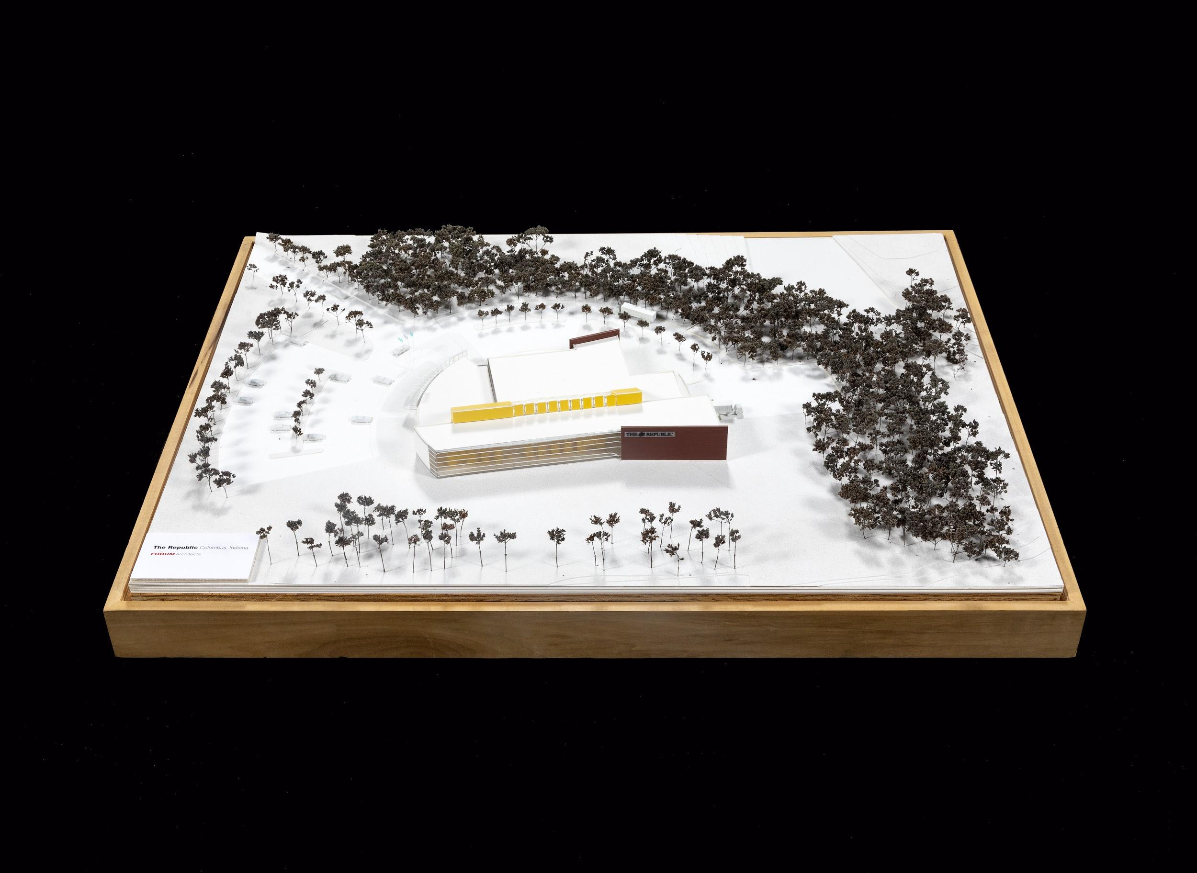
Low research value.
Returned to donor.

Slide 32
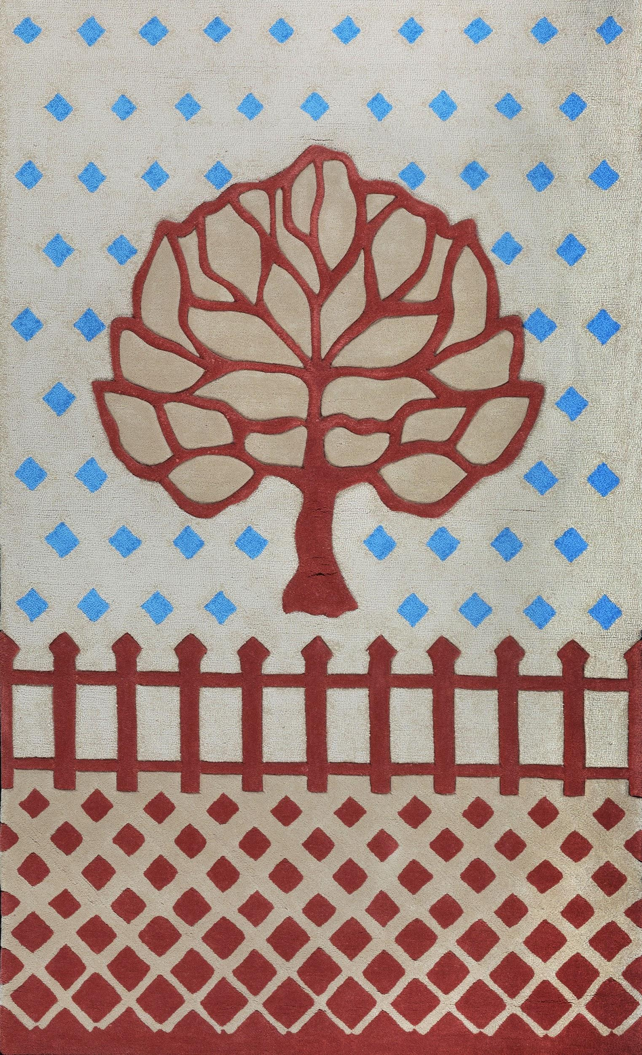
Does not advance mission.
Sell.

Slide 33
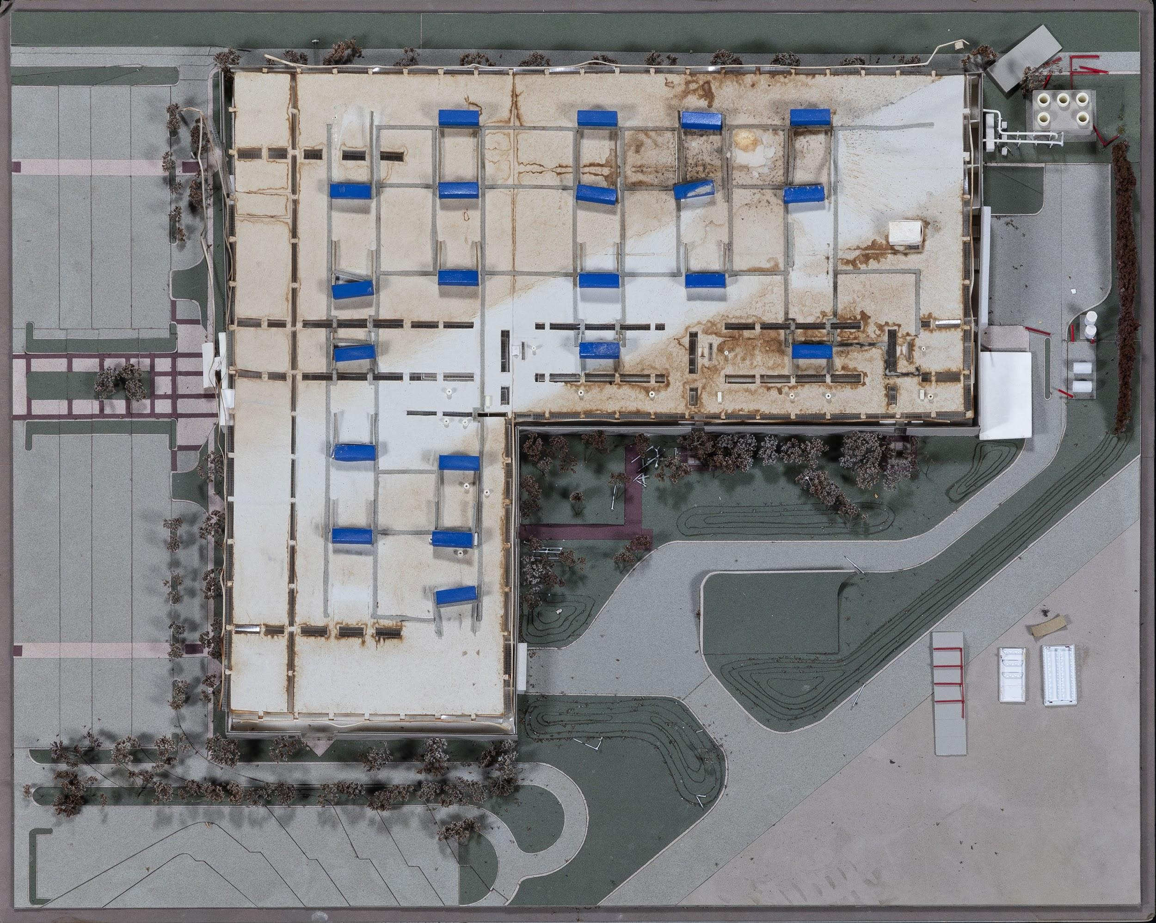
Damaged or deteriorated beyond reasonable repair.
Destroyed.

Slide 34
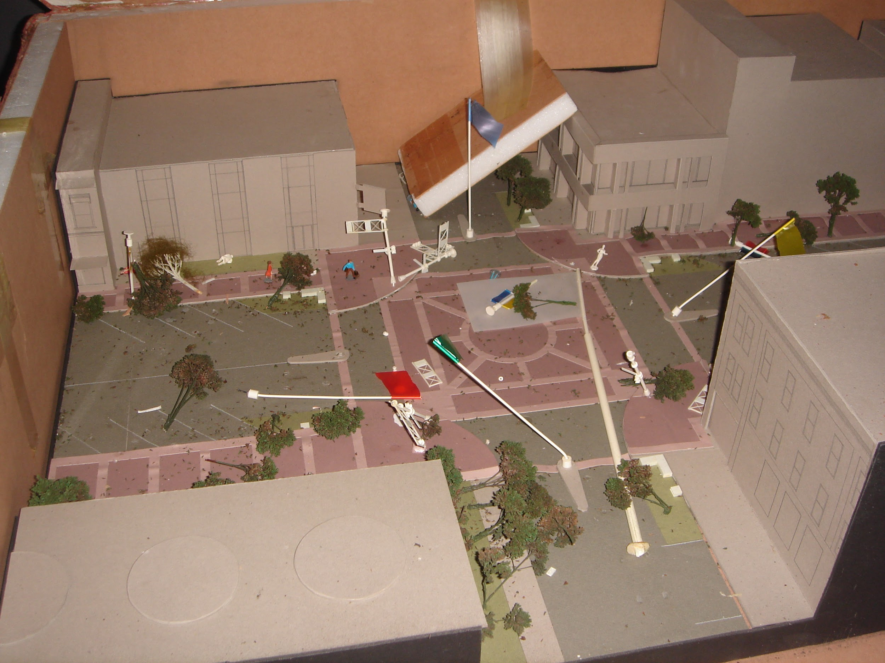
Condition threatens collection.
Destroyed.

Slide 35
Step 5
Evaluate!
Celebrate!

Slide 36
Tricia Gilson
Archivist
Columbus Indiana
Architectural Archives
Less Product, More Joy
Part 2
Jeannine Roe
Electronic Records Archivist
Indiana Archives & Records Administration

Slide 37
Refusing Refuse:
Retention, Mission, and the
Case for “Pre-appraisal”

Slide 38
Definitions
Reappraisal
The process of identifying materials that are candidates for deaccessioning.
Pre-appraisal (or pre-weeding)
The process of identifying materials that can be culled from an accession prior to transmittal.

Slide 39
It starts with policy

Slide 40
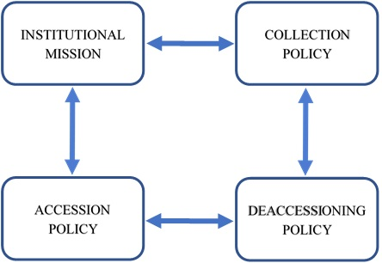
In a perfect world...
Joy
HARMONY
LOVE

Slide 41
What can policy do for you?
Uphold your institutional mission
Provide some legal protection
Strengthen your position when you are put in a situation where you should not or do not want to accept certain records
Allow for defensible disposal/destruction
Can aid in writing internal procedural documents for more consistent processing workflows
There are many quality examples and templates online!

Slide 42
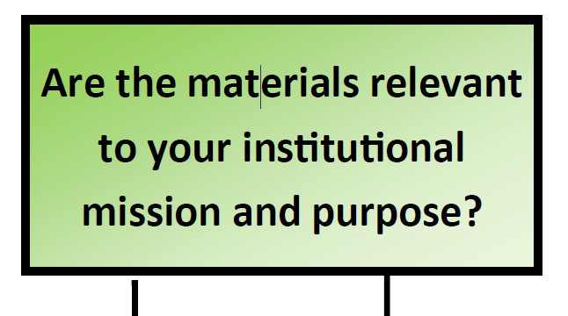
Collecting practices should support your
mission & purpose

Slide 43
As technology evolves, we have new considerations

Slide 44
“Selective appraisal policies and practices should include regular reappraisal. Initial appraisal decisions do not always stand the test of time, and, given the continual costs—environmental and otherwise—of preserving digital content, reappraisal should be standard practice. Reappraisal should include, among other factors such as use metrics and value, an assessment of the current and ongoing environmental costs of preservation.”
Pendergrass, et al
Toward Environmentally Sustainable Digital Preservation. (2019). The American Archivist 82 (1), p. 184.

Slide 45
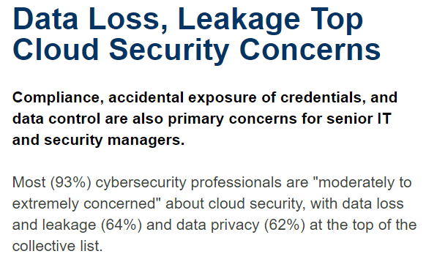
“The Cloud” isn’t perfect!
https://www.synopsys.com/software-integrity/resources/analyst-reports/security-in-the-cloud.html
https://cloudwars.co/azure-cloud-failures-microsoft-reliability/
https://www.zdnet.com/article/google-details-catastrophic-cloud-outage-events-promises-to-do-better-next-time/

Slide 46
It’s also expensive.

Slide 47
But we still have to deal with the backlog
Guidelines for Efficient Archival Processing in the University of California Libraries, p. 15. https://libraries.universityofcalifornia.edu/groups/files/hosc/docs/_Efficient_Archival_Processing_Guidelines_v3-1.pdf

Slide 48
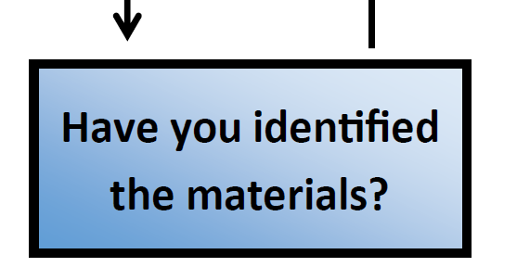
It may be relevant but not permanent

Slide 49
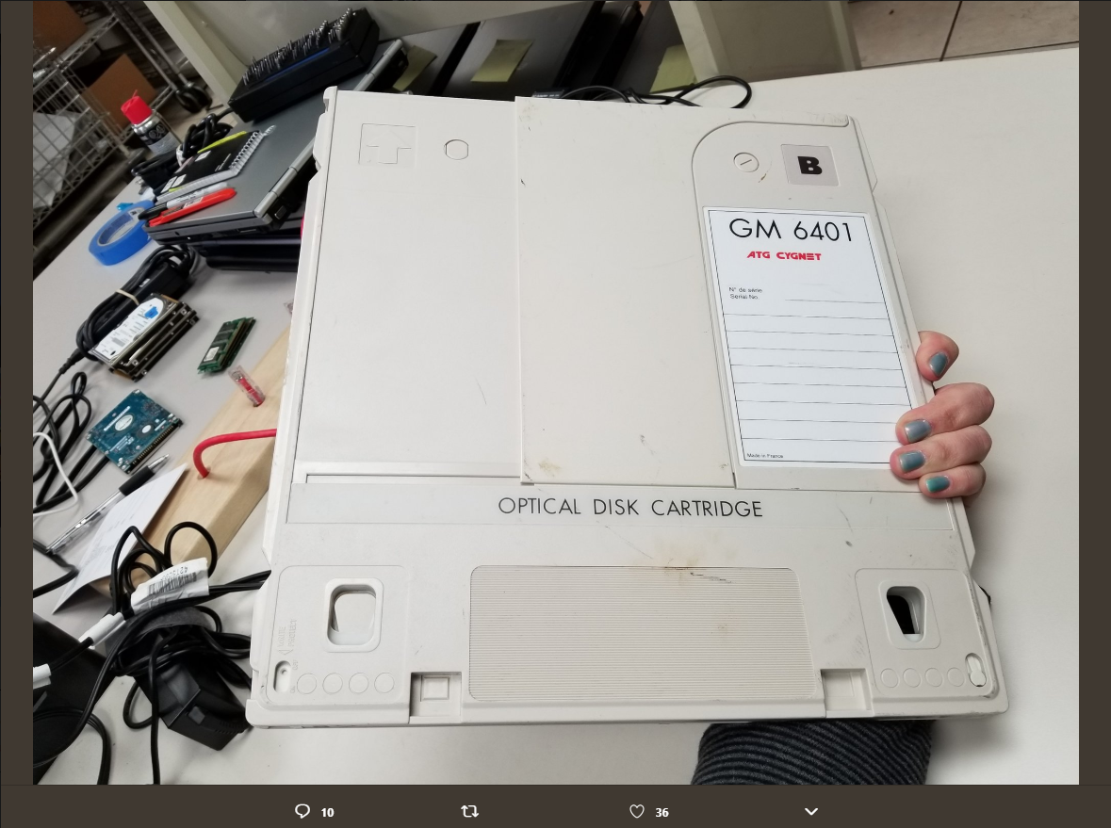
Example 1
Proposed cost:
Refurbish drive = $7,010
Test 3 platters = $2,250
$9,260
Convert 30 @
$750 each = $22,500
$31,760
Convert 60 @
$750 each = $45,000
$54,260
Original image posted to Twitter March 4, 2019 by (꒪▿꒪) everything is terrible‏ @sacaitlin

Slide 50
Should records be weeded because of their format?
What makes a record a record?
Content
Creator
Decisions made around
retention and disposition

Slide 51
Example 2
When you have means, motive, and opportunity to pre-weed, DO SO!
74 video channels with 772 videos total Estimated 700 GB of data
5% sample Agency input to determine priority materials Agency responsible for organizing and transmitting
ISDH video center: http://videocenter.isdh.in.gov/videos/

Slide 52
Less Product 2:
Scenarios with AV, electronic, and mixed materials
Live review with tools:
Command Line and Powershell
Karen’s Directory Printer
File Deduplicator
FTK Imager Lite

Slide 53
Sometimes
You just aren’t sure what you have

Slide 54
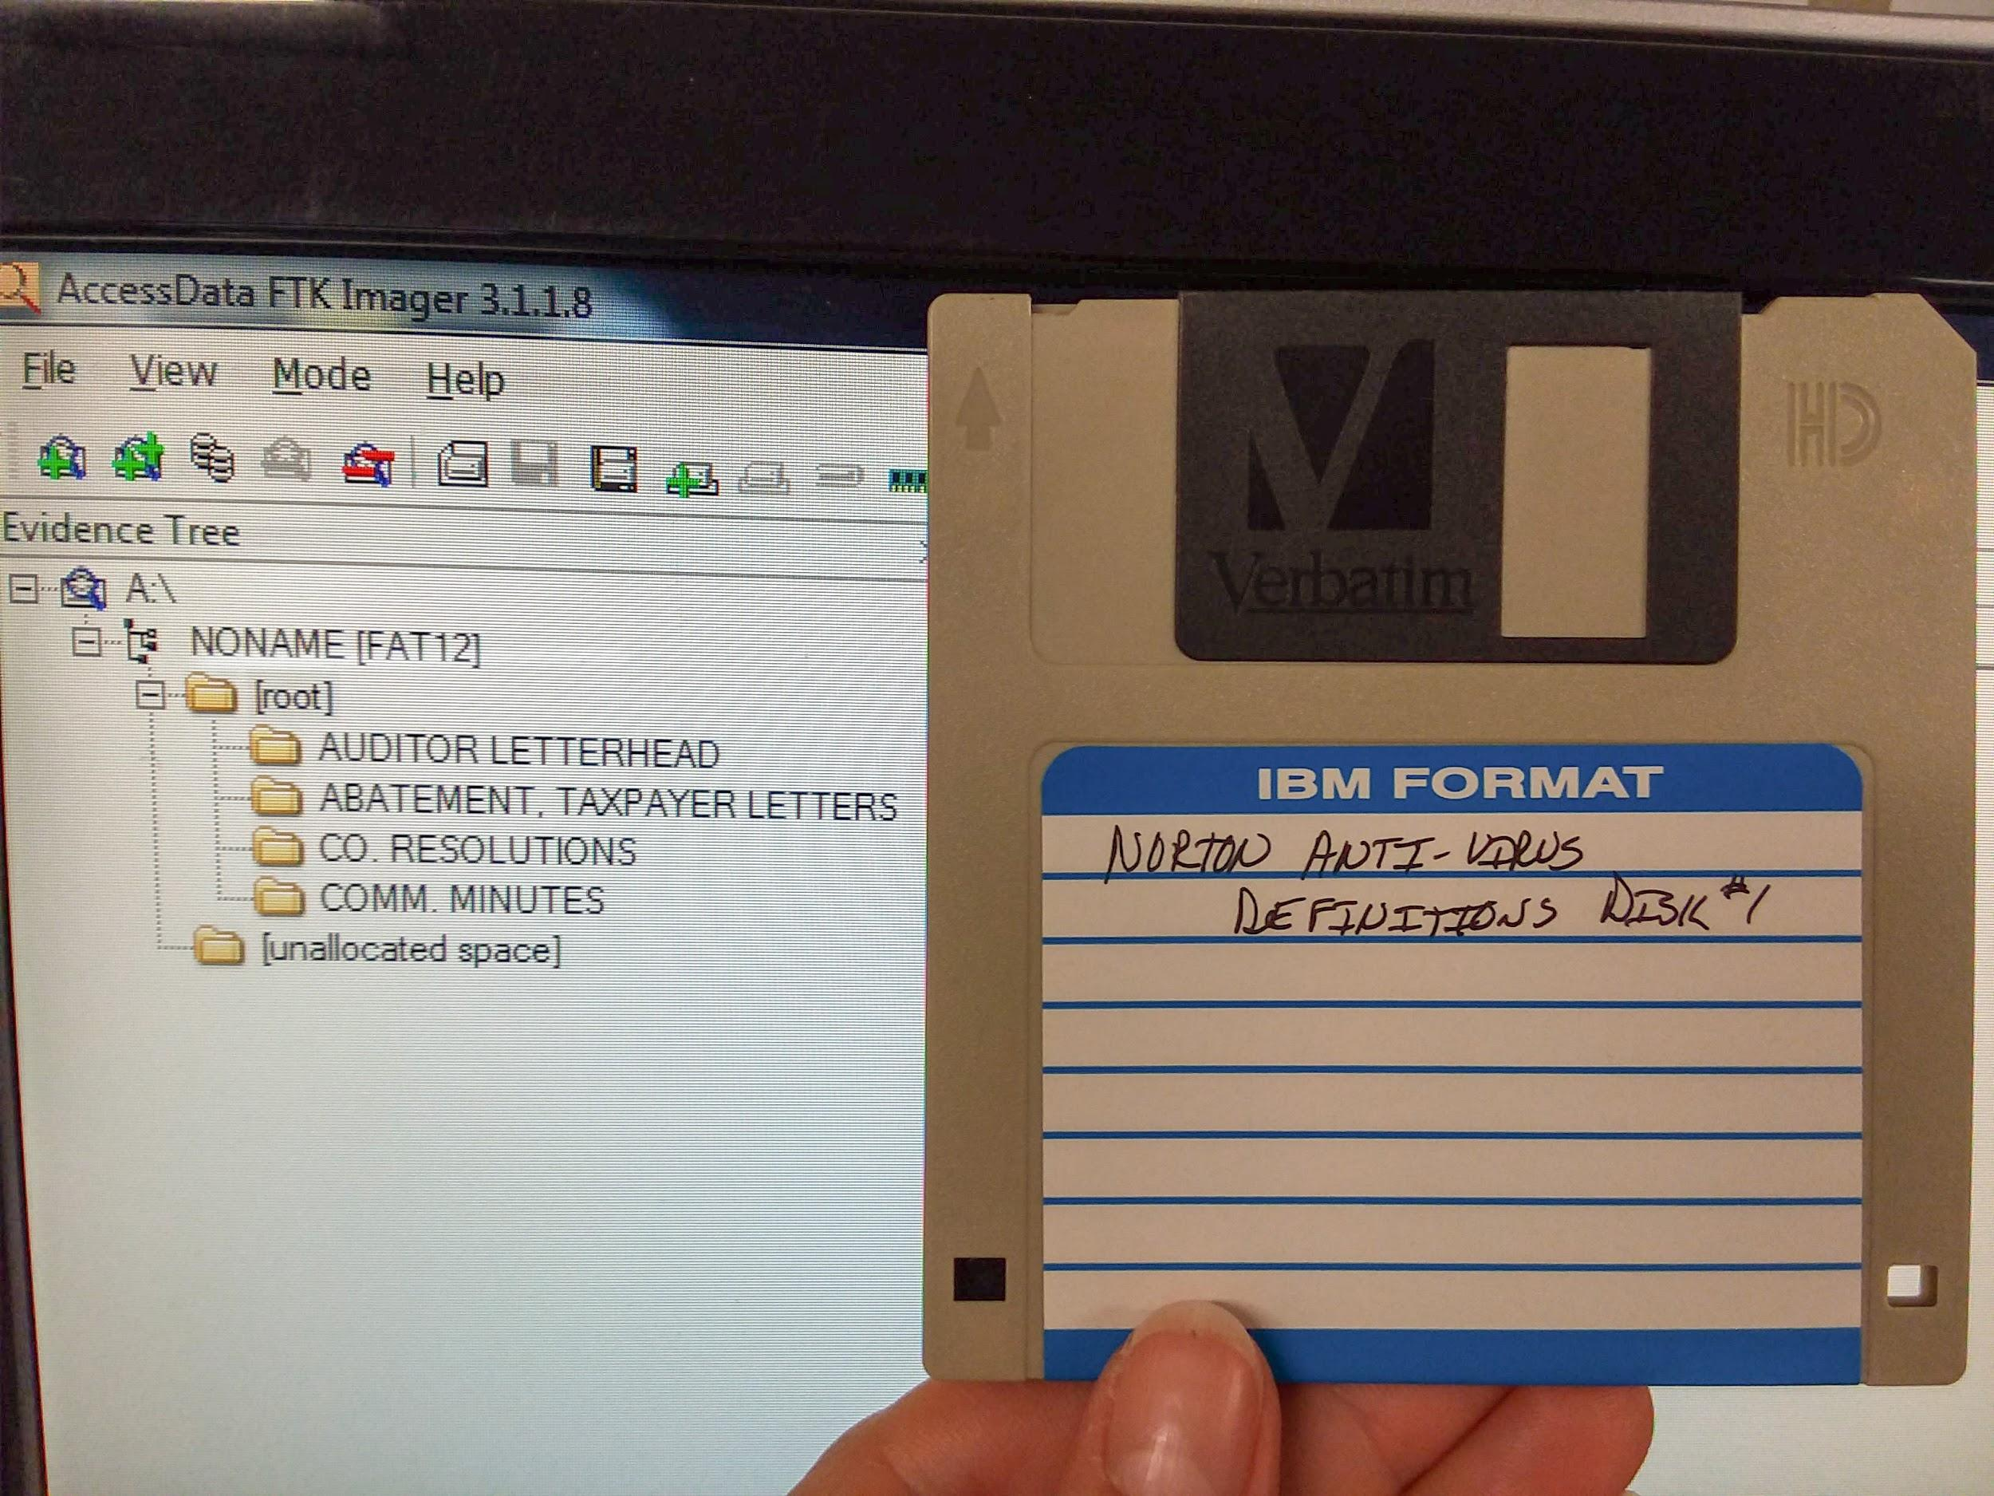
Content verification - it’s important!

Slide 55
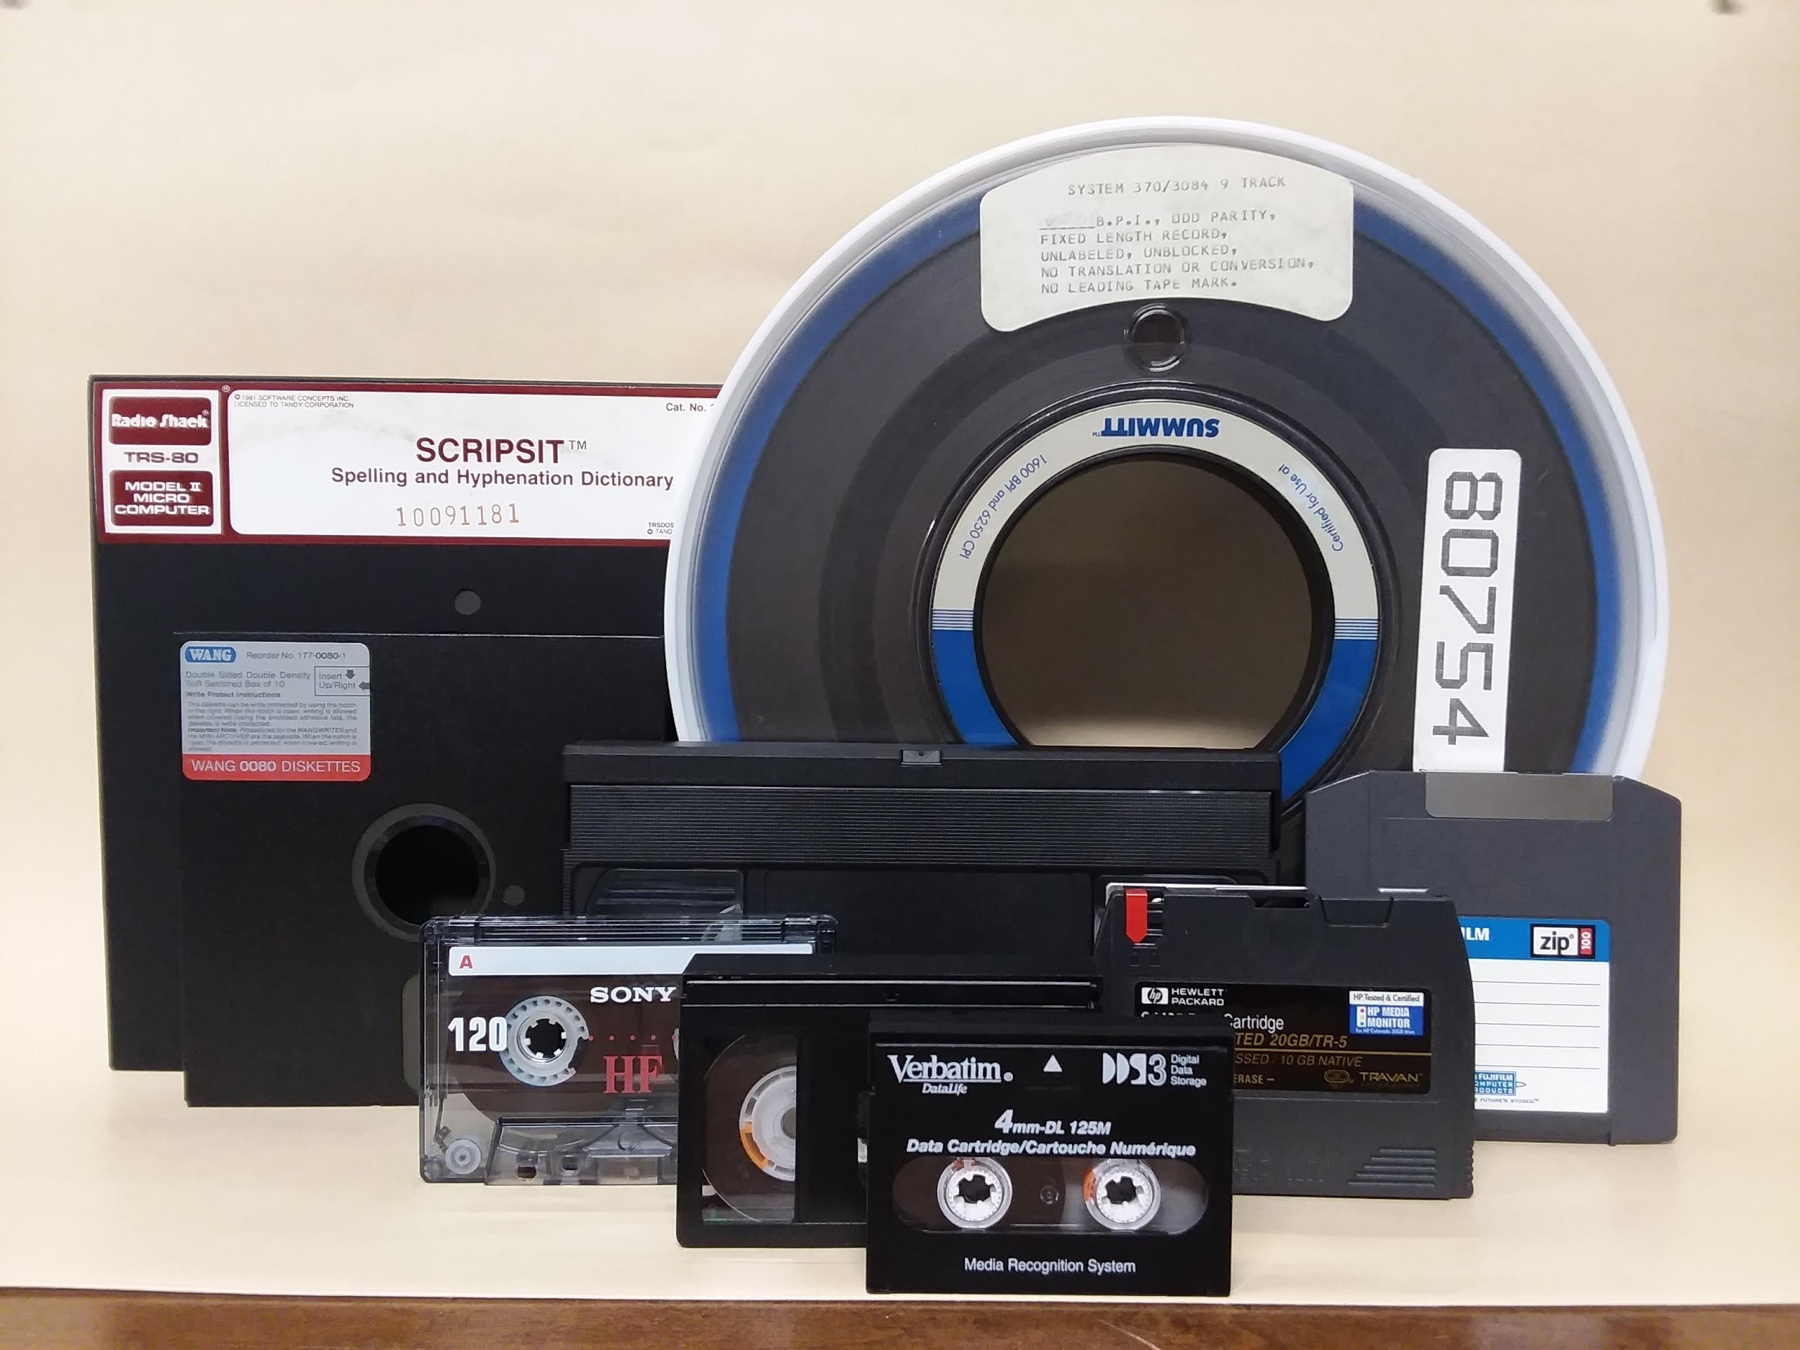
IDK what even are these?

Slide 56
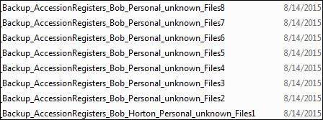
Ghosts of accessions past...

Slide 57
There are plenty of free or inexpensive tools out there that can help you determine what you have so you can define scope and make plans.

Slide 58
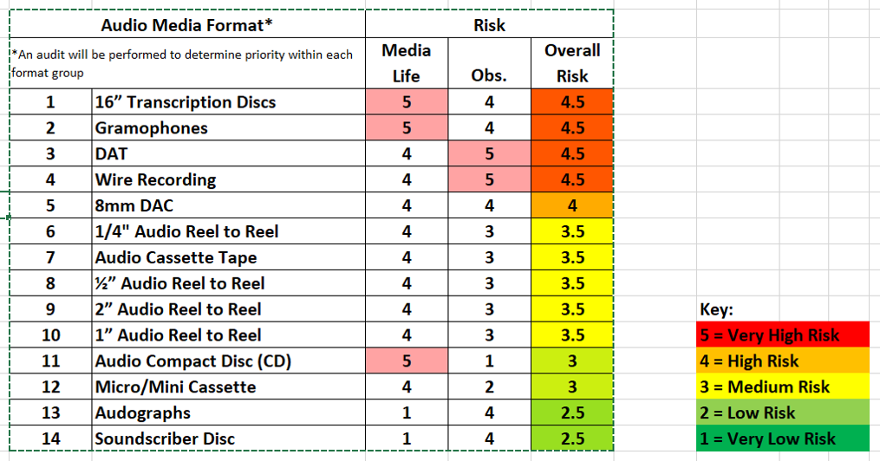
Prioritize decision making (many guides and tools already exist)
Digital Preservation Matters Risk Matrix and blog: http://preservationmatters.blogspot.com/2018/11/preservation-of-av-materials-in.html

Slide 59
Example 3: weeding digital photos from disks
Set up boiler plate criteria for consistency, then add specific notes as needed.
Files were weeded according to the following criteria:
duplicate (exact copy)
extremely similar shots (multiple nearly identical images of the same subject were taken)
unrelated to the collection (out of scope)
blurry, blank, black, unidentifiable, or otherwise unusable image
unreadable or unrecoverable file
temp file, empty file or thumbnail cache file
content is non-archival (e.g. test shots)
For this accession, Word documents were recovered and retained. MOV video snippets were determined to be non-archival and weeded.

Slide 60
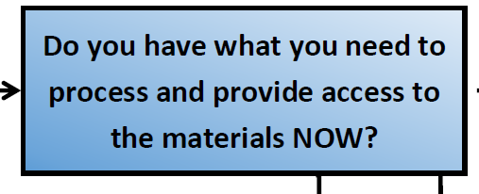
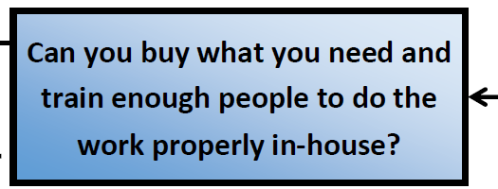
Once you know what you have...
what do you plan to do with it?

Slide 61
Tools can be used to apply retention and disposition to your internal operating documents as well as to accessioned materials.
Demo time!

Slide 62
Low-hanging fruit
What’s the easy stuff to get rid of? (paper)
duplicates
scratch paper
blank forms
envelopes
drafts/versions (for some types of records)
empty folders/boxes
out of scope
not actually produced by creator/donor
memos, advertisements, generic mail
superfluous reference materials
What’s the easy stuff to get rid of? (electronic)
duplicates
drafts/provisional versions/working documents (for some types of records)
empty folder/file directories
temp files
unrecoverable files
out of scope
not actually produced by creator/donor
(external documentation delivered by other agencies and used for reference)

Slide 63
Activity
Example accession
1 c.f. of electronic records (est. 14 TB total), including:
- (3) 4 TB hard drives
- (1) 2 TB hard drive
- (9) USB flash drives
- (~400) CD-Rs containing video files
12 c.f. of Report Forms
- One folder for every day containing a signed record packet for each event held, documenting a secure and auditable transaction (2-4 recordings per day)
How would you weed the records and organize the 5% sample that will be retained?

Slide 64
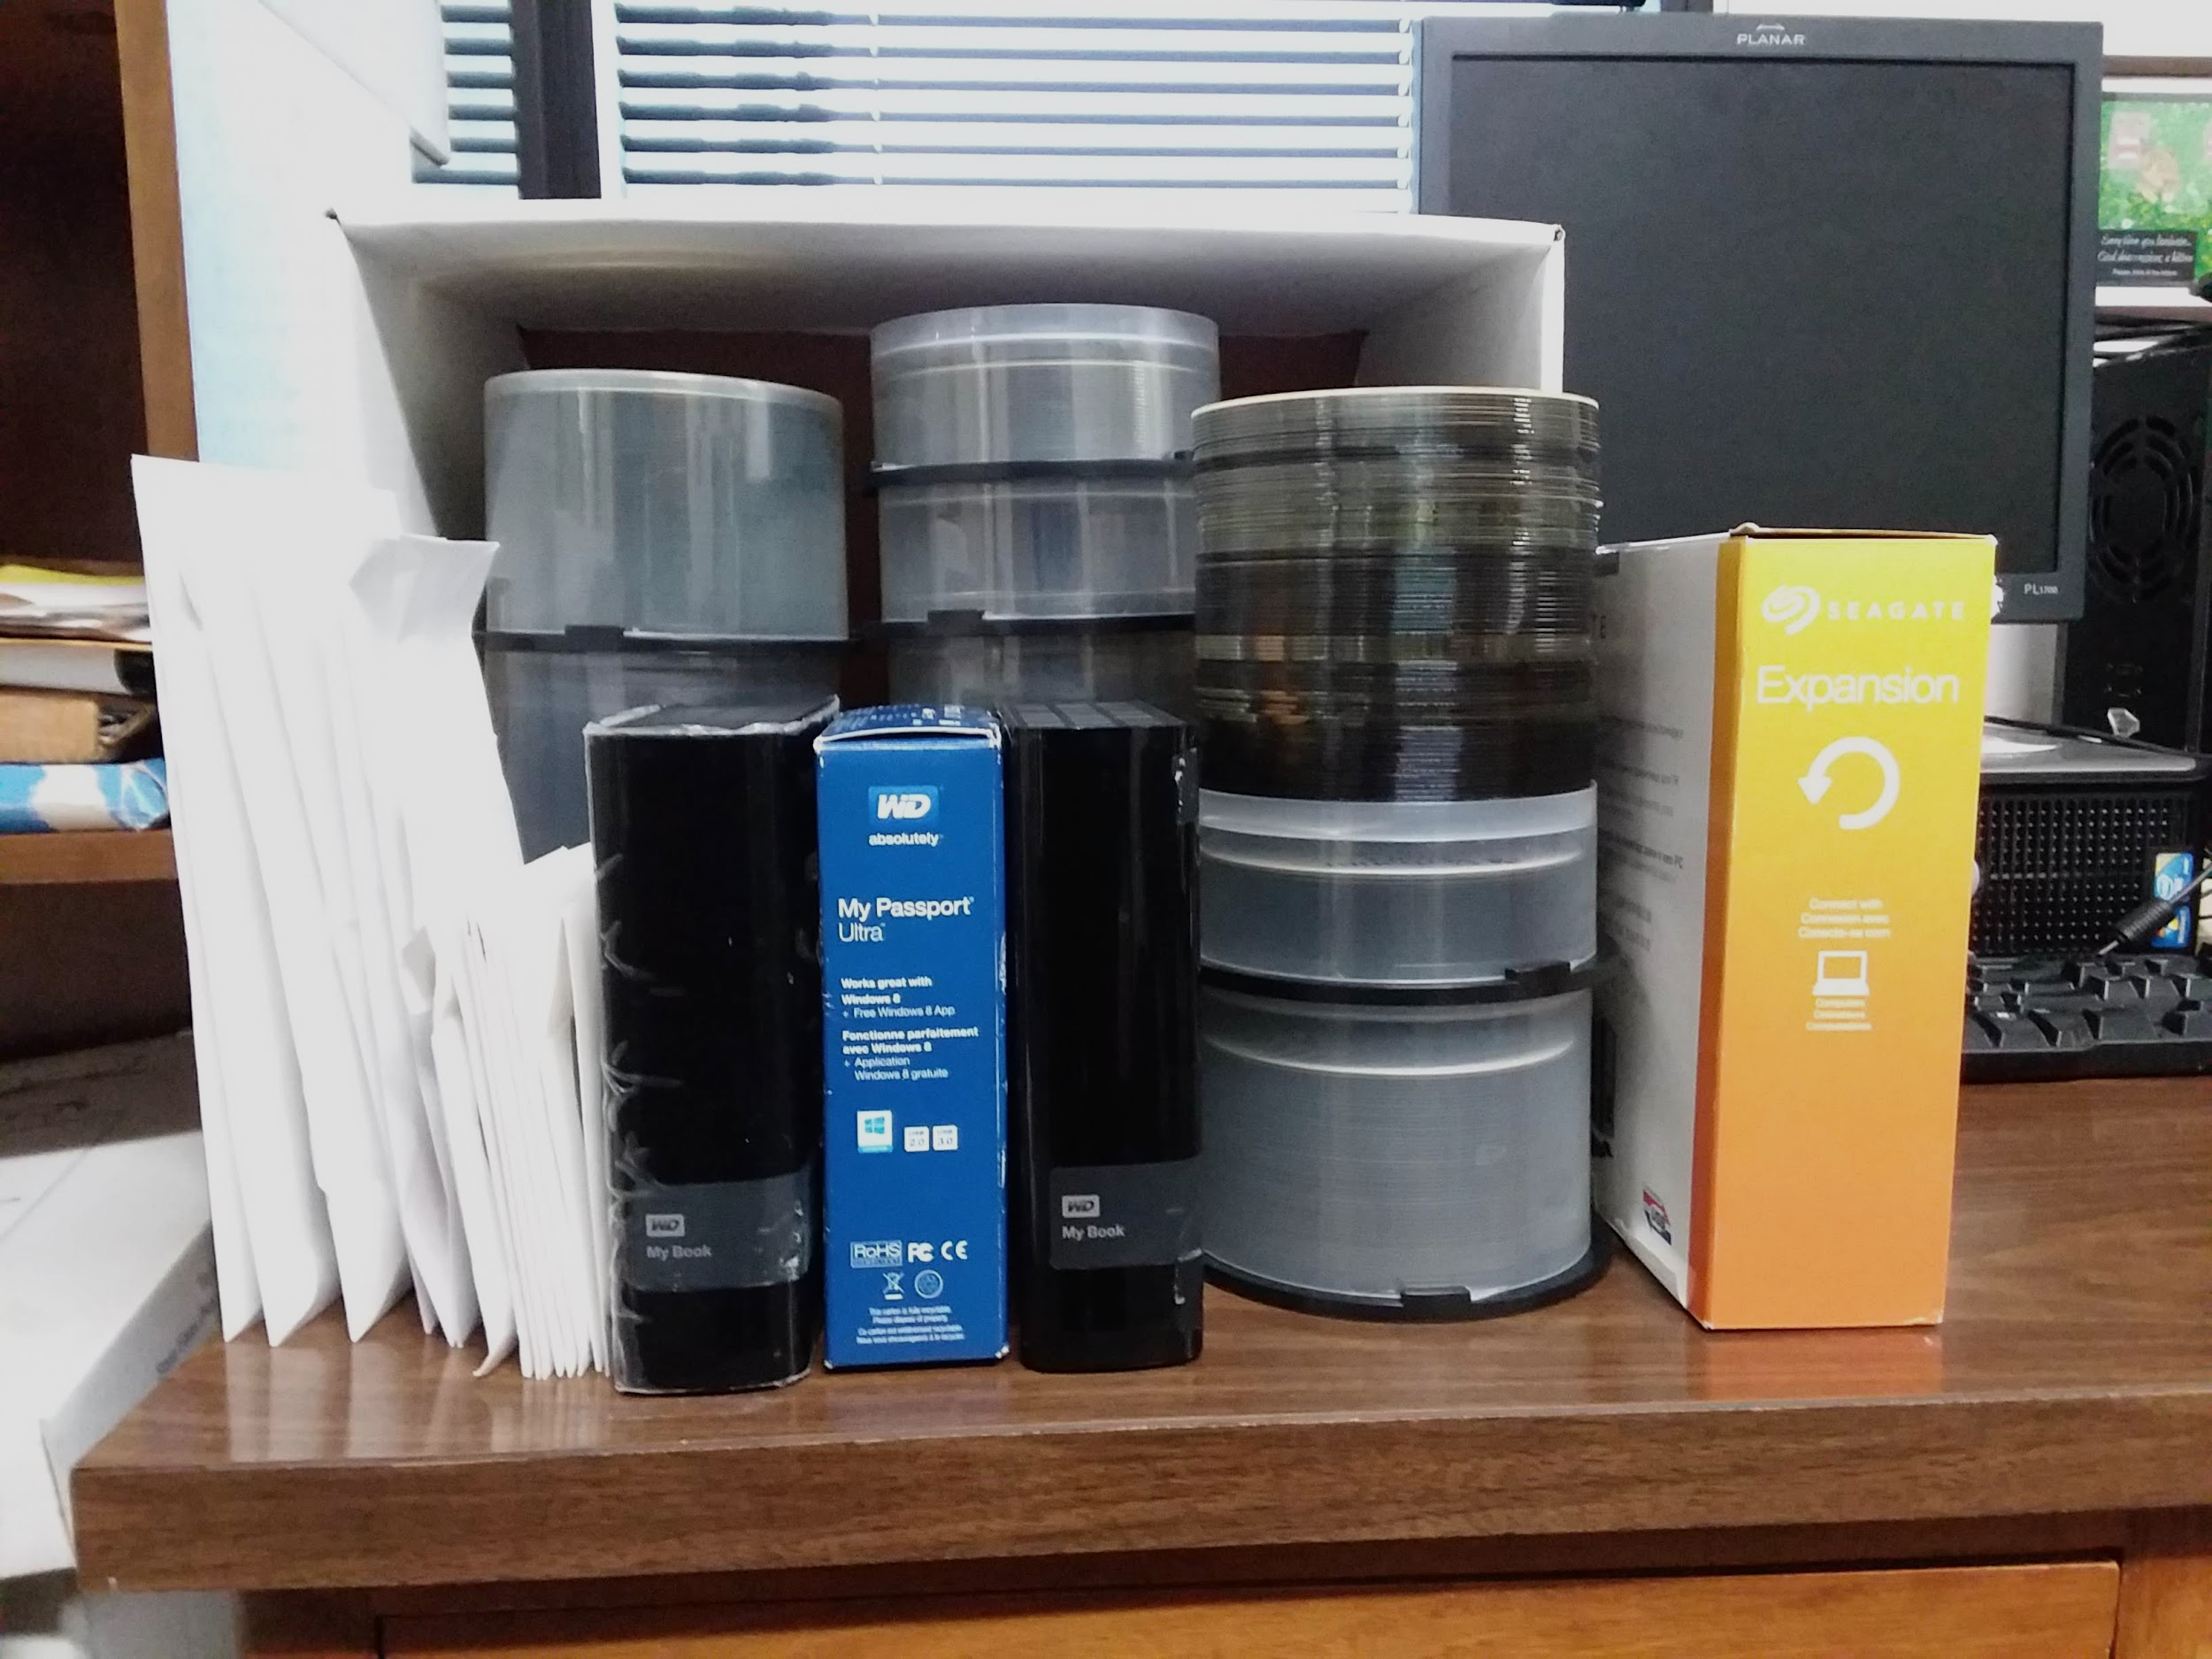

Slide 65
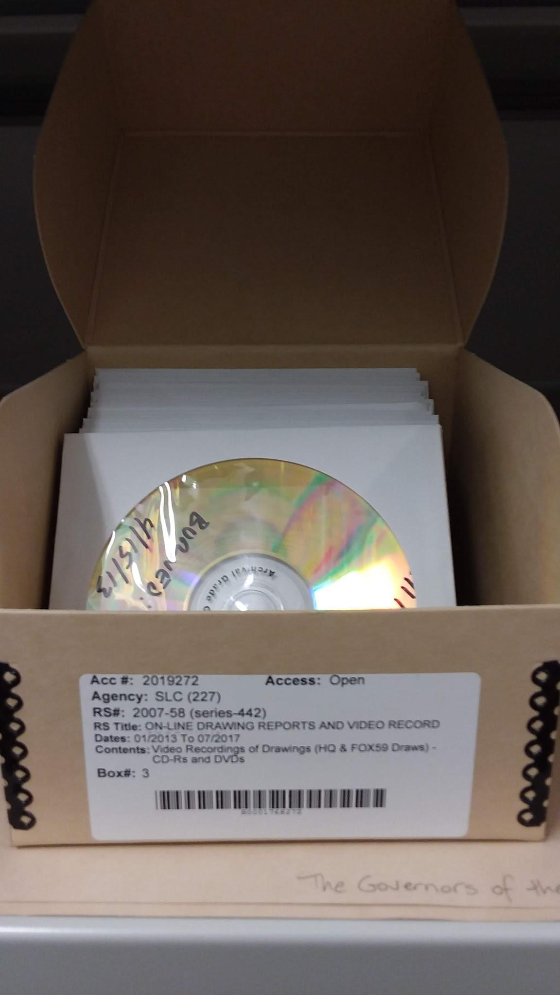
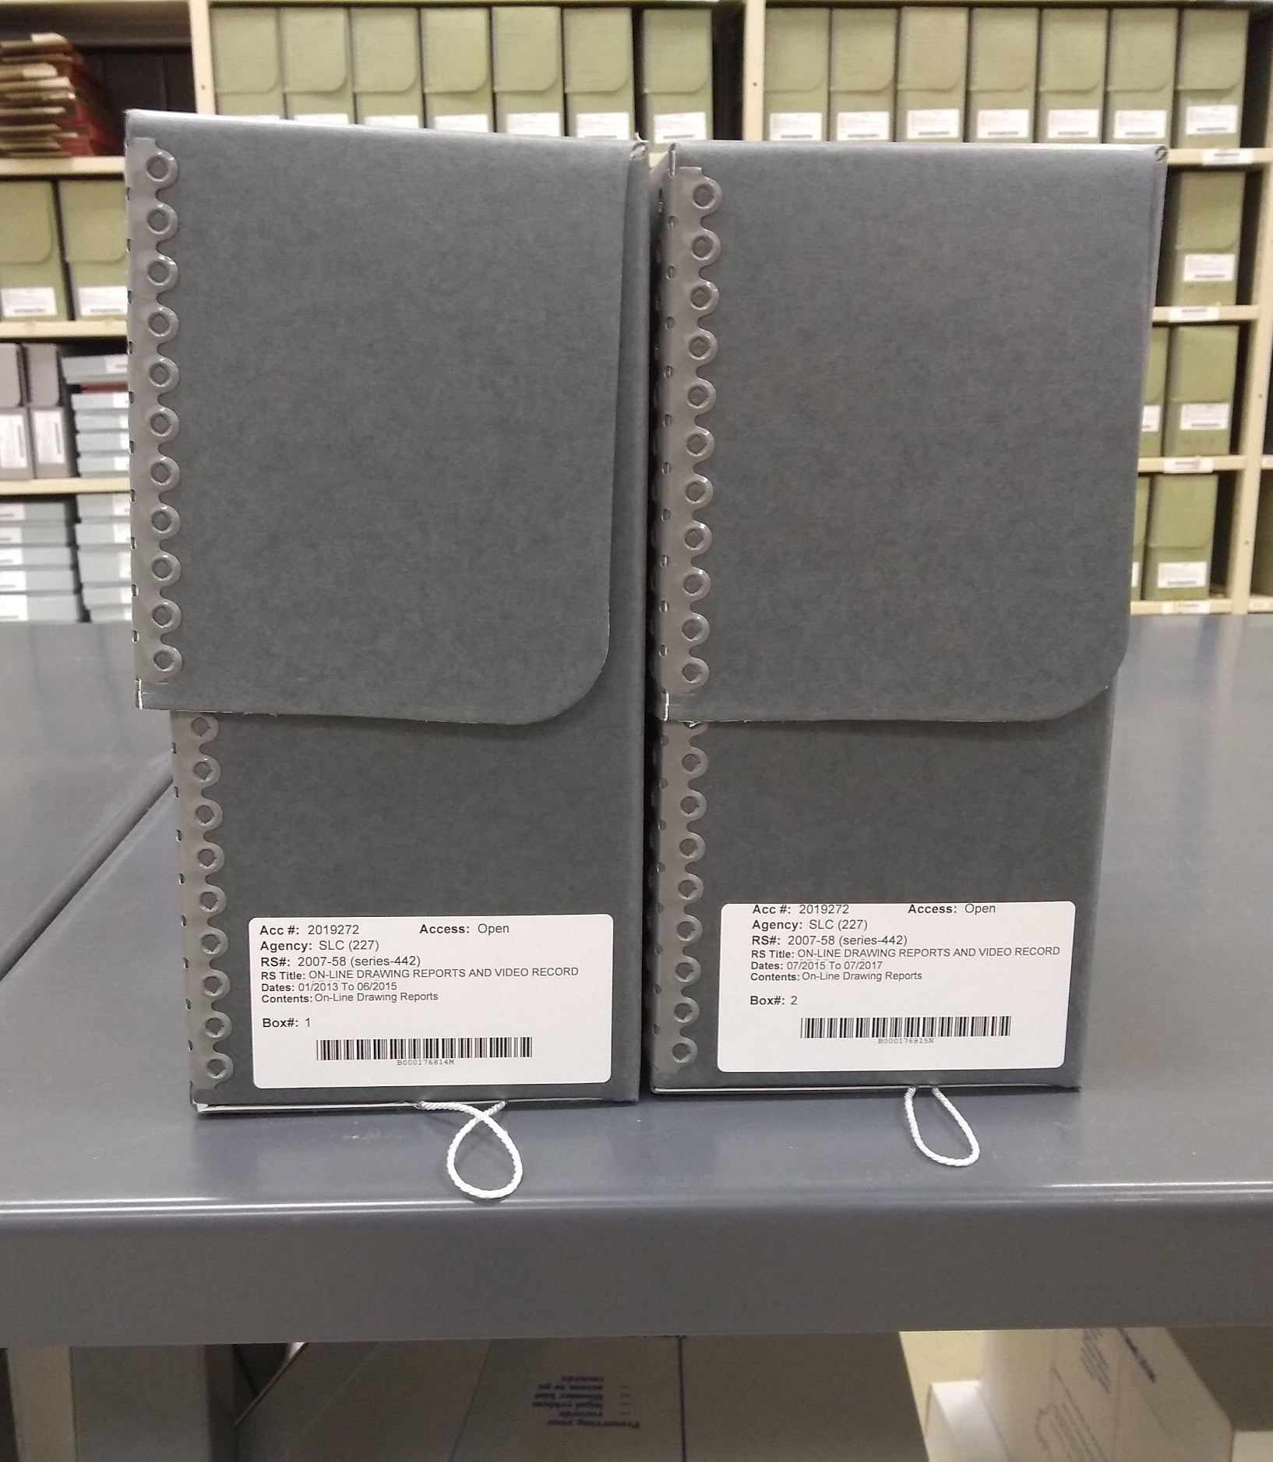
Digital files on NAS connected by record series and accession number
+
+

Slide 66
“Taking proper care of your collection does mean not spending your limited collection care resources on objects that do not help you accomplish your [institution’s] goals.”
John E. Simmons
The Deaccessioning Dilemma: Laws, Ethics, and Actions.
https://www.connectingtocollections.org/the_deaccessioning_dilemma_laws_ethics_and_actions/

Slide 67
Some thoughts...
What are your hopes for your newly defined/redefined collection?
Throughout the process -- WHY are you deaccessioning? (maintain focus or review overall purpose)
What are the strengths of the collection? Is the process upholding them?
If you are entirely unable to make certain materials accessible to your audience, do you need to keep caring for them?

Slide 68
More Joy
Q & A
CONTACT JEANNINE:
Email: jroe1@iara.in.gov
Phone: 317-232-3658
Address: 402 W. Washington St., W472 Indianapolis, IN 46204
Institutional Twitter: @IndianaArchives
Personal Twitter: @MLSingInAction
CONTACT TRICIA:
Email: tgilson@mybcpl.org
Phone: 812-379-1297
Address: Bartholomew County Public Library 536 Fifth Street, Columbus, IN 47201
Institutional Instagram: @columbusarchives

